Slide 1
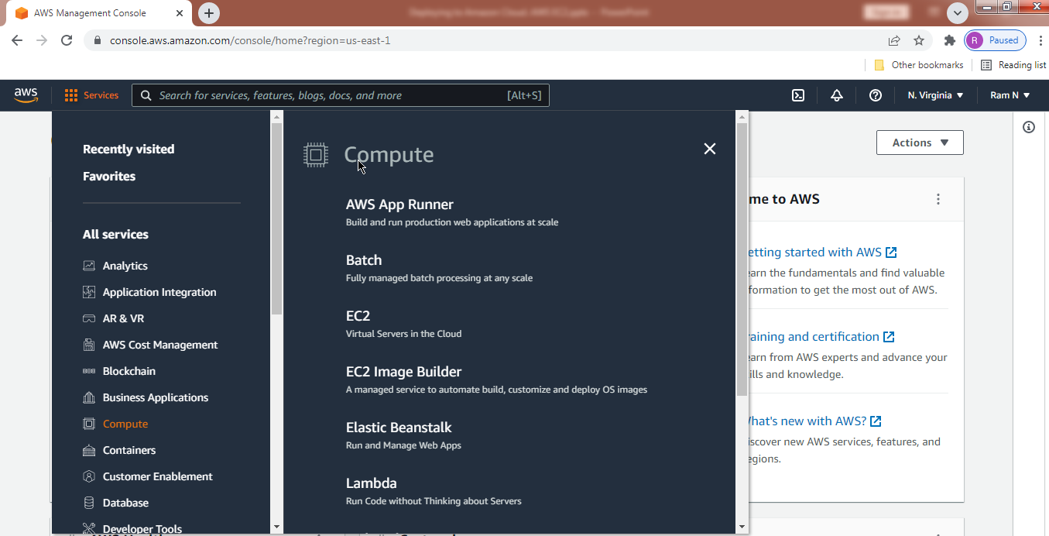
Spring Boot - Deploying to Amazon Cloud. AWS EC2
https://console.aws.amazon.com/console/home?region=us-east-1

Slide 2
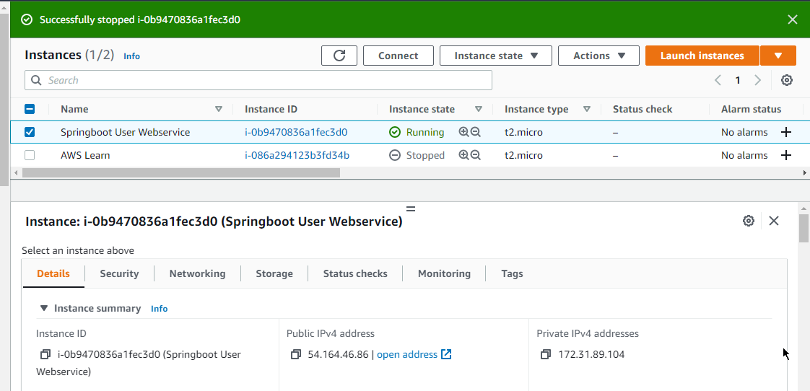
Spring Boot - Deploying to Amazon Cloud. AWS EC2
Startup Your Own Amazon EC2 Linux Server

Slide 3
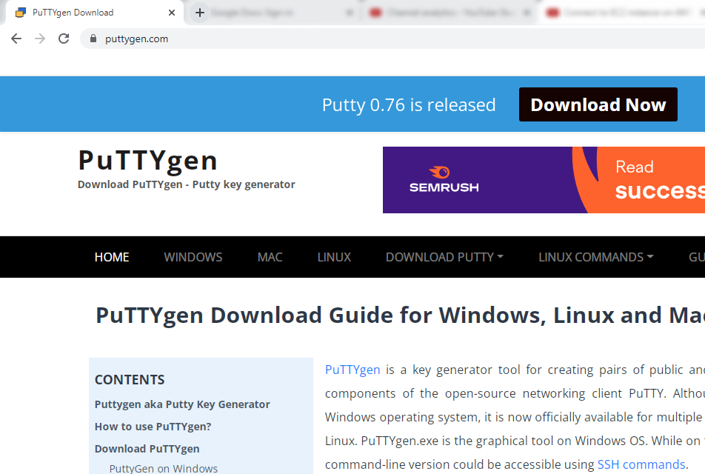
Spring Boot - Deploying to Amazon Cloud. AWS EC2
How to Connect to EC2 instance on AWS using PUTTY?
https://www.puttygen.com/

Slide 4
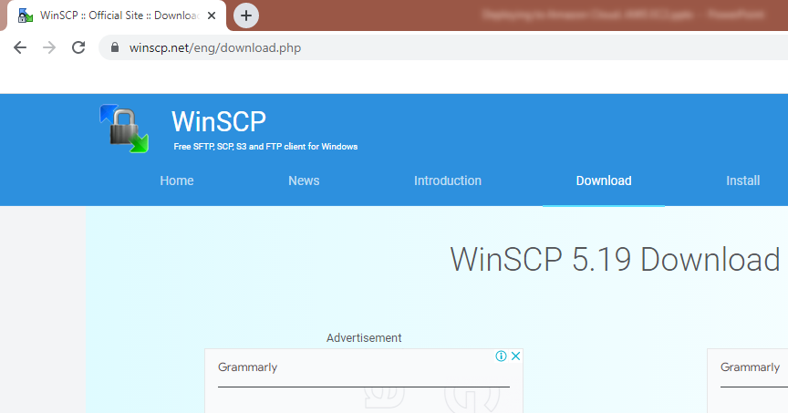
Spring Boot - Deploying to Amazon Cloud. AWS EC2
How to Connect to EC2 instance on AWS by FTP using WinSCP?
https://winscp.net/eng/download.php

Slide 5
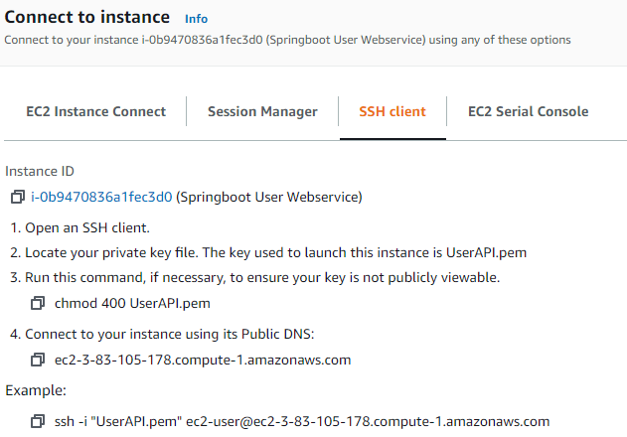
Spring Boot - Deploying to Amazon Cloud. AWS EC2
How to Connect to EC2 instance via SSH?
Linux Machine
SSH
Amazon EC2 Instance

Slide 6

Spring Boot - Deploying to Amazon Cloud. AWS EC2
How to Update EC2 Server Software Packages and Update Java?
sudo yum update
[ec2-user@ip-172-31-89-104 ~]$ java -version
[ec2-user@ip-172-31-89-104 ~]$ yum list java*
[ec2-user@ip-172-31-89-104 ~]$ sudo yum install java-1.8.0

Slide 7
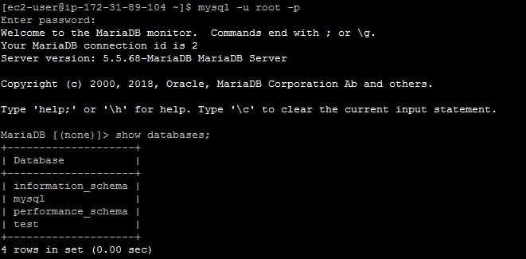
Spring Boot - Deploying to Amazon Cloud. AWS EC2
How to download and Install MariaDB on EC2 Linux Server?
[ec2-user@ip-172-31-89-104 ~]$ yum list mariadb*
[ec2-user@ip-172-31-89-104 ~]$ sudo yum install mariadb-server.x86_64
[ec2-user@ip-172-31-89-104 ~]$ sudo systemctl start mariadb
[ec2-user@ip-172-31-89-104 ~]$ sudo systemctl enable mariadb

Slide 8
Spring Boot - Deploying to Amazon Cloud. AWS EC2
How do I reset the MariaDB root password on an Amazon EC2 instance?
By default, MariaDB 5.5 on Amazon Linux 2 doesn't have a root password. If you create a root password for MariaDB and then lock yourself out of your database, you must reset the root password.
1. Verify that you have a recent snapshot of the volume(https://docs.aws.amazon.com/AWSEC2/latest/UserGuide/ebs-creating-snapshot.html#ebs-create-snapshot%20:%20Creating%20Amazon%20EBS%20Snapshots%20-%20Creating%20a%20Snapshot) on which the MariaDB data directory resides. You can recreate the volume from this snapshot, if needed.
Stop the MariaDB service:
sudo systemctl stop mariadb
3. Start MariaDB in safe mode:
sudo mysqld_safe --skip-grant-tables --skip-networking &
4. Log in to the MariaDB monitor:
mysql -u root
5. Update your MariaDB root password:
UPDATE mysql.user SET Password = PASSWORD('new_password_here') WHERE User = 'root';
The output looks like this:
Query OK, 1 row affected (0.00 sec)
Rows matched: 1 Changed: 1 Warnings: 0

Slide 9
Spring Boot - Deploying to Amazon Cloud. AWS EC2
How do I reset the MariaDB root password on an Amazon EC2 instance?
6. Flush the privileges to reload the grant tables. Your new password takes effect after the reload.
FLUSH PRIVILEGES;
7. Exit the MariaDB monitor:
exit
8. Stop the MariaDB process:
sudo kill `sudo cat /var/run/mariadb/mariadb.pid`
Note: The process might take a few seconds to terminate.
9. Start the MariaDB service:
sudo systemctl start mariadb
10. Test your new MariaDB root password:
mysql -u root -p

Slide 10
Spring Boot - Deploying to Amazon Cloud. AWS EC2
How to download & Install Apache Tomcat on AWS EC2 Linux Server?
https://tomcat.apache.org/download-90.cgi
[ec2-user@ip-172-31-89-104 ~]$ cd /tmp
[ec2-user@ip-172-31-89-104 tmp]$ pwd
/tmp
[ec2-user@ip-172-31-89-104 tmp]$
You can use the wget command to download the Tomcat zip file to the /tmp directory, a temporary folder location.
wget https://dlcdn.apache.org/tomcat/tomcat-9/v9.0.62/bin/apache-tomcat-9.0.62.tar.gz
$ sudo mkdir /opt/tomcat
$ tar -xf apache-tomcat-9.0.62.tar.gz
$ sudo mv apache-tomcat-9.0.62 /opt/tomcat/

Slide 11
Spring Boot - Deploying to Amazon Cloud. AWS EC2
How to download & Install Apache Tomcat on AWS EC2 Linux Server?
$ sudo chown -R ec2-user: /opt/tomcat
$ sudo sh -c 'chmod +x /opt/tomcat/apache-tomcat-9.0.62/bin/*.sh'
$ cd /opt/tomcat/apache-tomcat-9.0.62/bin
$ ./catalina.sh start
$ ./catalina.sh stop

Slide 12
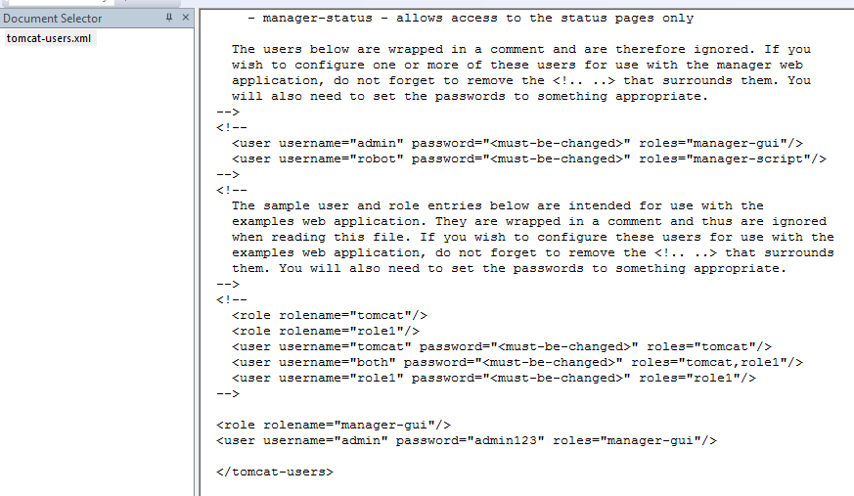
Spring Boot - Deploying to Amazon Cloud. AWS EC2
How to Configure Apache Tomcat Users?

Slide 13
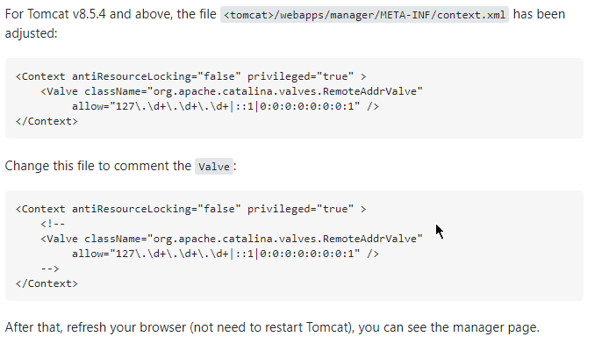
Spring Boot - Deploying to Amazon Cloud. AWS EC2
How to Access Tomcat Manager App from different host?
By default the Host Manager is only accessible from a browser running on the same machine as Tomcat. If you wish to modify this restriction, you'll need to edit the Host Manager's context.xml file.

Slide 14
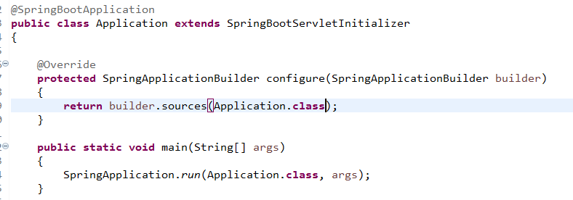
Spring Boot - Deploying to Amazon Cloud. AWS EC2
How to Generate WAR file and deploy Our Web Service App on Apache Tomcat?
Tomcat Server in EC2 Instance
user-app-ws.war

Slide 15
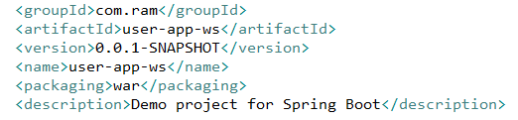
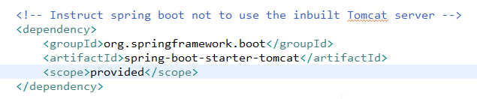
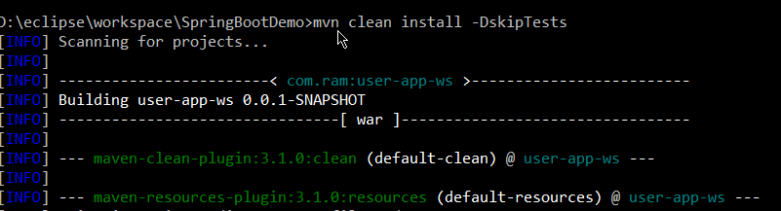
Spring Boot - Deploying to Amazon Cloud. AWS EC2
How to Generate WAR file and deploy Our Web Service App on Apache Tomcat?
To skip the test case during maven clean install i used -DskipTests paramater in following command
>mvn clean install -DskipTests

Slide 16
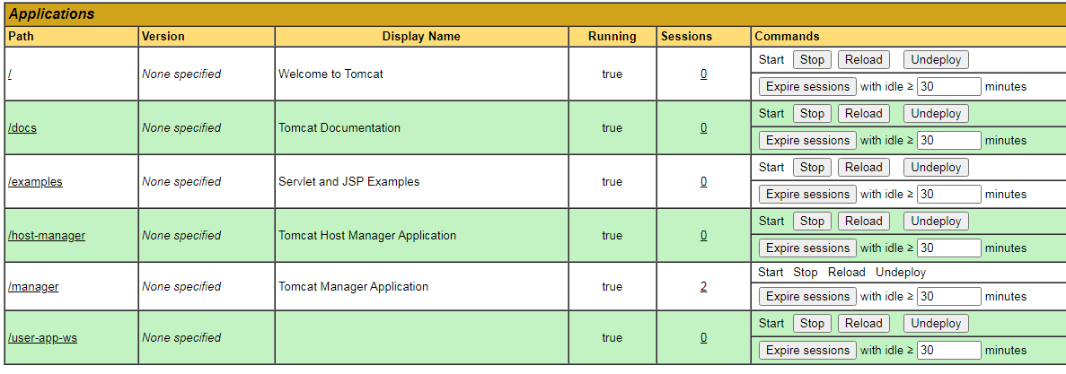
Spring Boot - Deploying to Amazon Cloud. AWS EC2
How to Generate WAR file and deploy Our Web Service App on Apache Tomcat?
$ sudo systemctl start mariadb
$ mysql -u root
$ mysql -uroot –proot
> SHOW DATABASES;
> CREATE DATABASE org_db;
> use org_db;
> show tables;

Slide 17
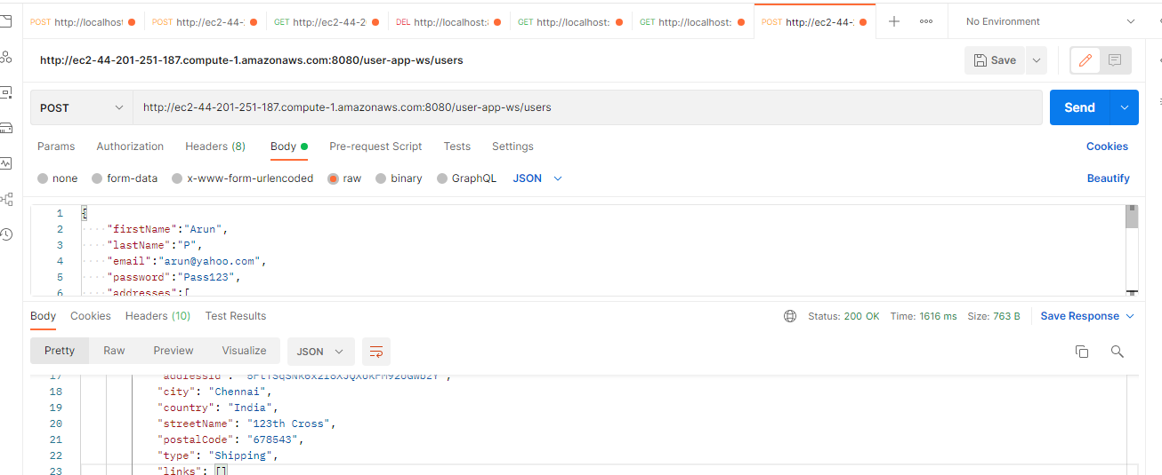
Spring Boot - Deploying to Amazon Cloud. AWS EC2
How to send HTTP Request to a Webservice Deployed on a Remote EC2 Server?

Slide 18
Spring Boot - Deploying to Amazon Cloud. AWS EC2
Putty keep alive
Connect DB run on ec2 workbench and sqlyog?
Tomcat yum install?

